Slide 1
Real-time Global Illumination
Introduction to a voxel-based hybrid method
Che Sun

Slide 2
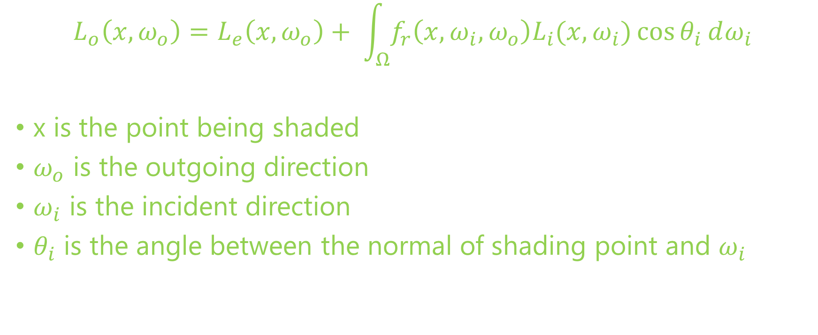
The Rendering Equation
$$L_{o}\left(x, ω_{o}\right)=L_{e}\left(x, ω_{o}\right)+ \int_{Ω}^{ }{f_{r}\left(x, ω_{i}, ω_{o}\right)L_{i}(x, ω_{i})\cos{θ_{i}}}ⅆω_{i}$$
x is the point being shaded
$ω_{o}$ is the outgoing direction
$ω_{i}$ is the incident direction
$θ_{i}$ is the angle between the normal of shading point and $ω_{i}$

Slide 3
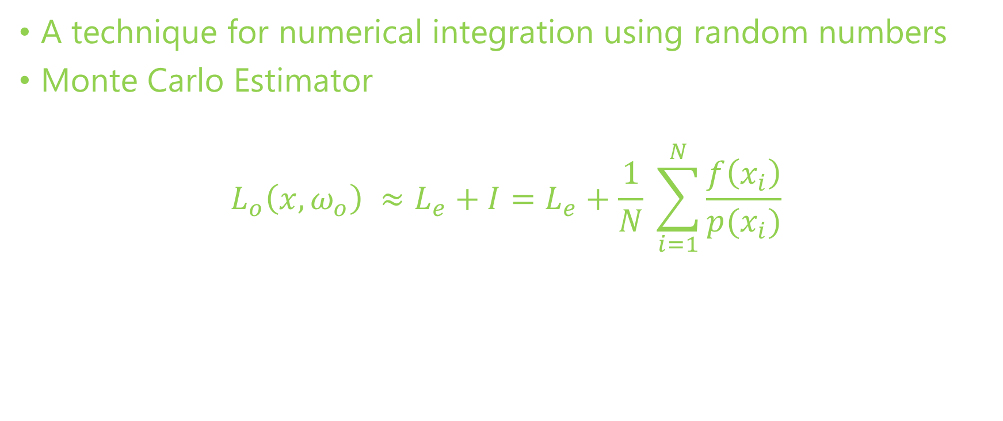
Monte Carlo Integration
A technique for numerical integration using random numbers
Monte Carlo Estimator
$$L_{o}\left(x, ω_{o}\right) ≈L_{e}+I=L_{e}+\frac{1}{N} \sum_{i=1}^{N}{\frac{f\left(x_{i}\right)}{p(x_{i})}}$$

Slide 4
State-of-the-art
Real-time Monte Carlo Methods
Many-light based method
Voxelization based method
Image-space based method
Real-time Partial Differential Equation (PDE) based Method
Numerical PDE solver of diffusion equation

Slide 5
A Novel Voxel-based Hybrid Method
Based on …
[Tokuyoshi 2012] Tokuyoshi, Yusuke, and Shinji Ogaki. "Real-time bidirectional path tracing via rasterization." Proceedings of the ACM SIGGRAPH Symposium on Interactive 3D Graphics and Games. ACM, 2012.
Thiedemann, Sinje, et al. "Voxel-based global illumination." Symposium on Interactive 3D Graphics and Games. ACM, 2011.
[Crassin 2011] Crassin, Cyril, et al. "Interactive indirect illumination using voxel cone tracing." Computer Graphics Forum. Vol. 30. No. 7. Blackwell Publishing Ltd, 2011.

Slide 6
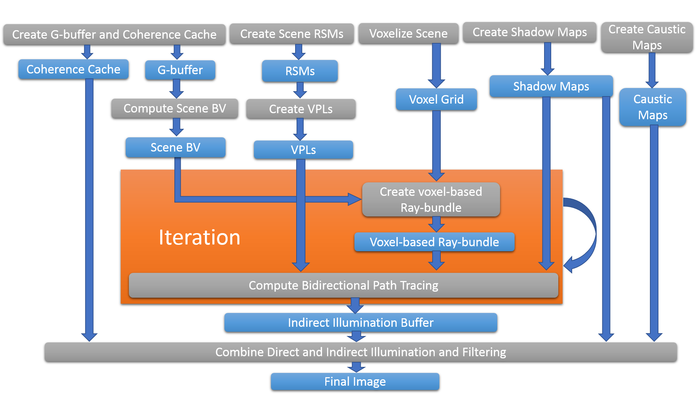
System Overview
Data
Algorithm

Slide 7
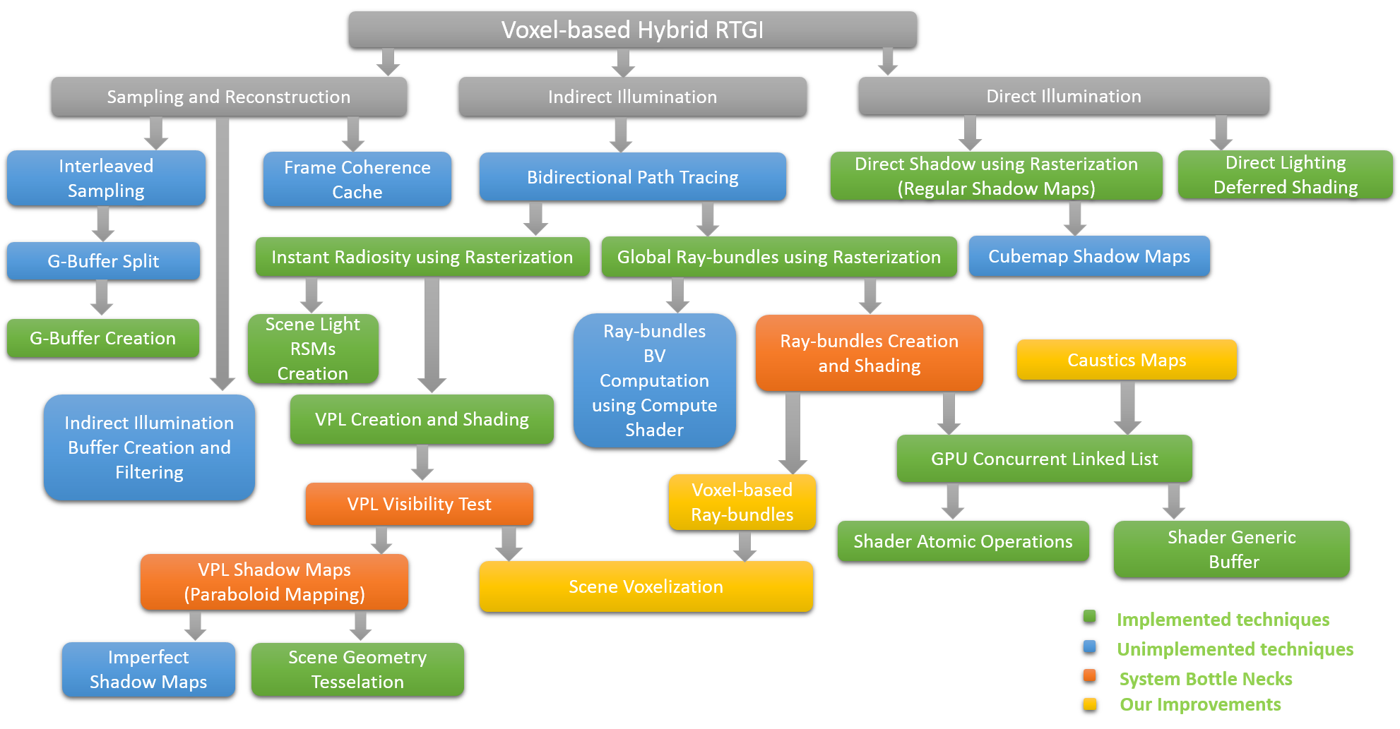
Technique Dependency

Slide 8
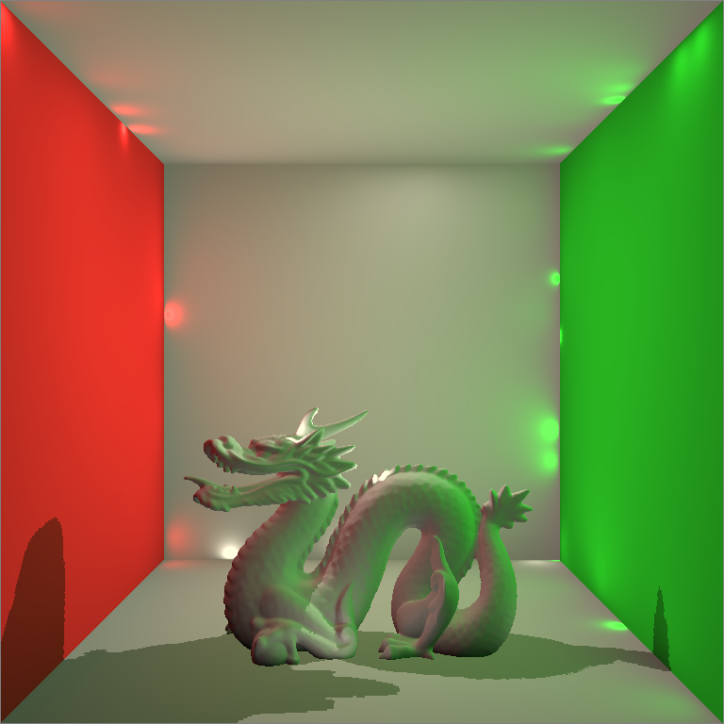
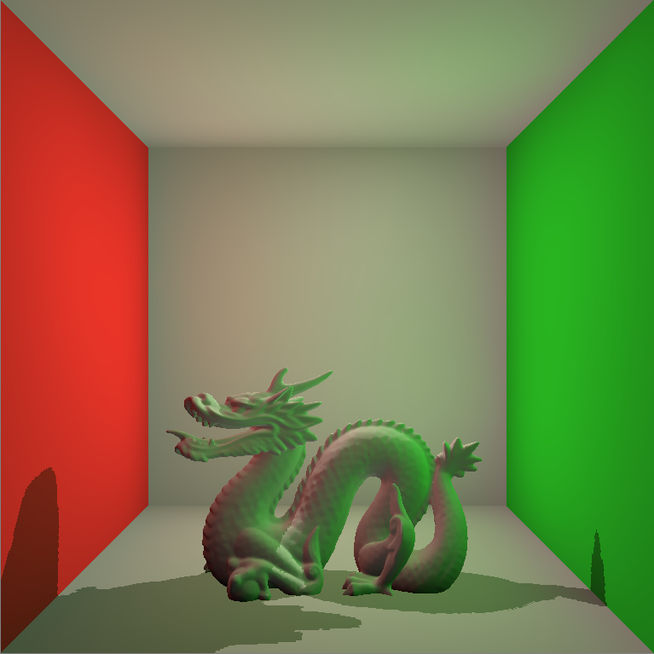
Real-time Virtual Point Lights Rendering
Naïve Implementation of Instant Radiosity
Depends on VPL Shadow Maps (Very slow!)
Classic Singularity Issue

Slide 9
Resolving the Singularity Issue by Clamping
Code Fragment
vec3 indirectColor = vec3(0.0, 0.0, 0.0);
for( int i = 0; i < VPLCount; ++i )
{
VPL vpl = VPLBuffer.vpls[i];
vpl.WorldNormal = vpl.WorldNormal*2.0 - 1.0;
vec3 incidentDir = PositionWorld.xyz - vpl.WorldPosition.xyz;
float len = length(incidentDir);
incidentDir = incidentDir / len;
float cos0 = max(0.0, dot(NormalWorld, -incidentDir));
float cos1 = max(0.0, dot(incidentDir, vpl.WorldNormal.xyz));
float geometricTerm = cos0 * cos1 / max(len*len, BounceSingularity);
indirectColor += MaterialColor.rgb * vpl.Flux.rgb * geometricTerm;
}
indirectColor = indirectColor * 2 * PI;
gl_FragData[0] = vec4(indirectColor, 1.0);

Slide 10
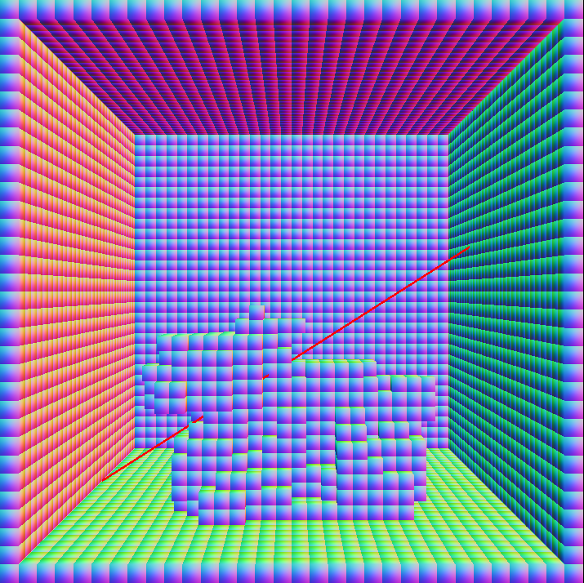
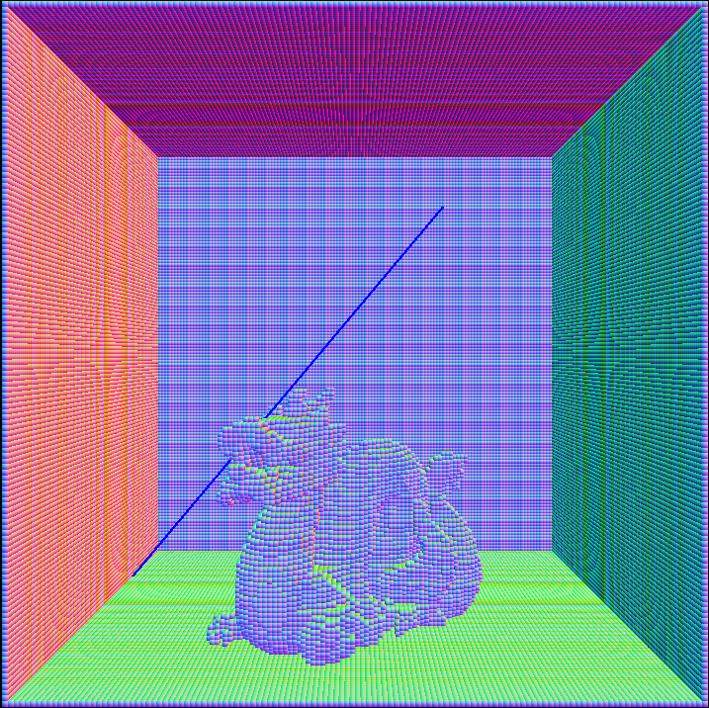
Resolving the VPL Shadow Maps Issue by Voxelization
Visibility Tests by Shadow Maps
Visibility Tests by Voxel Grid

Slide 11
Resolving the VPL Shadow Maps Issue by Voxelization
Code Fragment
AABB bb = GetTriangleAABB(vPositionWorld[0].xyz, vPositionWorld[1].xyz, vPositionWorld[2].xyz);
vec3 bbCenter = GetAABBCenter(bb);
vec3 bbExtension = GetAABBExtension(bb);
vec3 faceNormalWorld = vNormalWorld[0].xyz + vNormalWorld[1].xyz + vNormalWorld[2].xyz;
faceNormalWorld = normalize(faceNormalWorld);
mat3 matXYZ = mat3(X, Y, Z);
vec3 NdXYZ = faceNormalWorld * matXYZ;
float absNdX = abs(NdXYZ.x);
float absNdY = abs(NdXYZ.y);
float absNdZ = abs(NdXYZ.z);
int axis = 0;
if( absNdY > absNdX )
{
axis = 1;
if( absNdZ > absNdY )
{
axis = 2;
}
}

Slide 12
Resolving the VPL Shadow Maps Issue by Voxelization
Code Fragment Continues …
else
{
if( absNdZ > absNdX )
{
axis = 2;
}
}
mat4 ProjView = GetAxisViewProjTransforms(axis, bbCenter, bbExtension);
for( int i = 0; i < gl_in.length(); ++i )
{
gPositionWorld = vPositionWorld[i];
gNormalWorld = vNormalWorld[i];
gl_Position = ProjView * gl_in[i].gl_Position;
EmitVertex();
}
EndPrimitive();

Slide 13
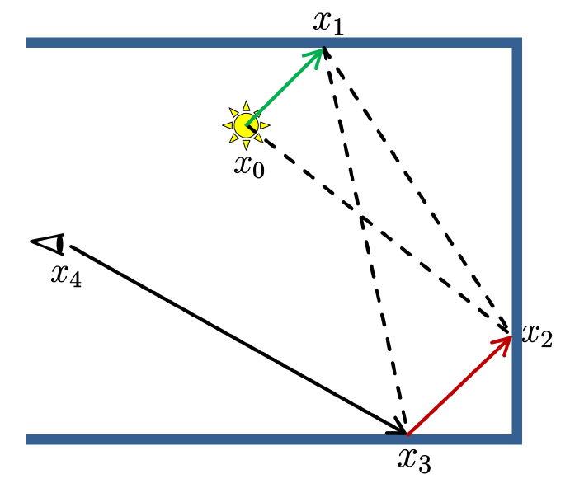
Bidirectional Path Tracing
A Robust Method Resolving the Singularity Issue
Connect the shading path from both
the VPL and Camera
Importance Sampling

